Slide 1
An Introduction to Software Engineering

Slide 2

What is Software?
Software is
instructions (computer programs) that when executed provide desired function and performance,
data structures that enable the programs to adequately manipulate information, and
documents that describe the operation and use of the programs.

Slide 3
Dual Role of Software
Software is a product
-Delivers computing potential (capability)
-Produces, manages, acquires, modifies, displays, or transmits information
Software is a vehicle (medium) for delivering a product
-Supports or directly provides system functionality
-Controls other programs (e.g., an operating system)
-Effects communications (e.g., networking software)
-Helps build other software (e.g., software tools)

Slide 4
Types of Software
Software products may be
Generic - developed to be sold to a range of different customers e.g. PC software such as Excel or Word.
Bespoke (custom) - developed for a single customer according to their specification. Examples – embedded control systems, air traffic control software, traffic monitoring systems.

Slide 5
Software Characteristics
Software is developed or engineered, it is not manufactured in the classical sense.
Software doesn't "wear out”.
The industry is moving toward component-based assembly, most software continues to be custom built.

Slide 6
Software is developed or engineered, it is not manufactured
Some similarities exist between software development and hardware manufacture,
-the two activities are fundamentally different.
High quality is achieved through good design, ⇨ in both case

Slide 7
Software is developed or engineered, it is not manufactured
In manufacturing phase for hardware can
-introduce quality problems that are nonexistent (or easily corrected) for software.
Both activities are dependent on people,
-but the relationship between people applied and work accomplished is entirely different
Software costs are concentrated in engineering.

Slide 8
Software doesn't "wear out”
Hardware exhibits relatively high failure rates early in its life.
Defects are corrected and the failure rate drops to a steady-state level.
The failure rate rises again as hardware components suffer from the cumulative effects of dust, vibration, abuse, temperature extremes, and many other environmental maladies.
For these reason hardware begins to “wear out”.

Slide 9
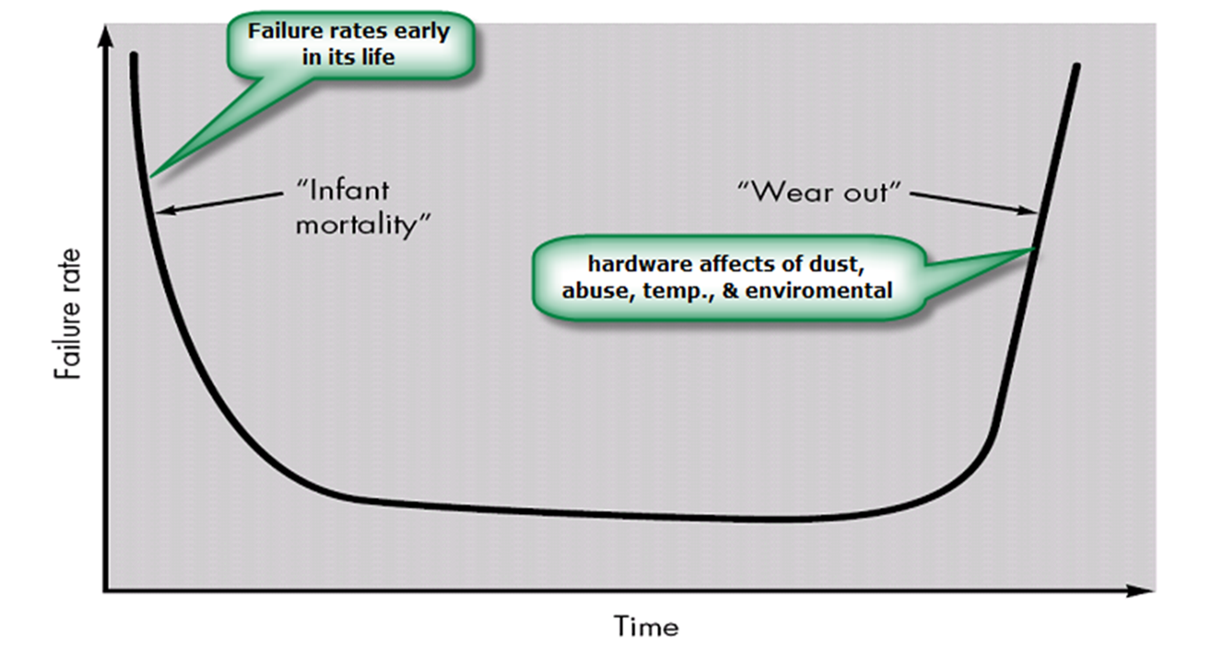
Failure Rate Curve or Bathtub Curve for Hardware

Slide 10
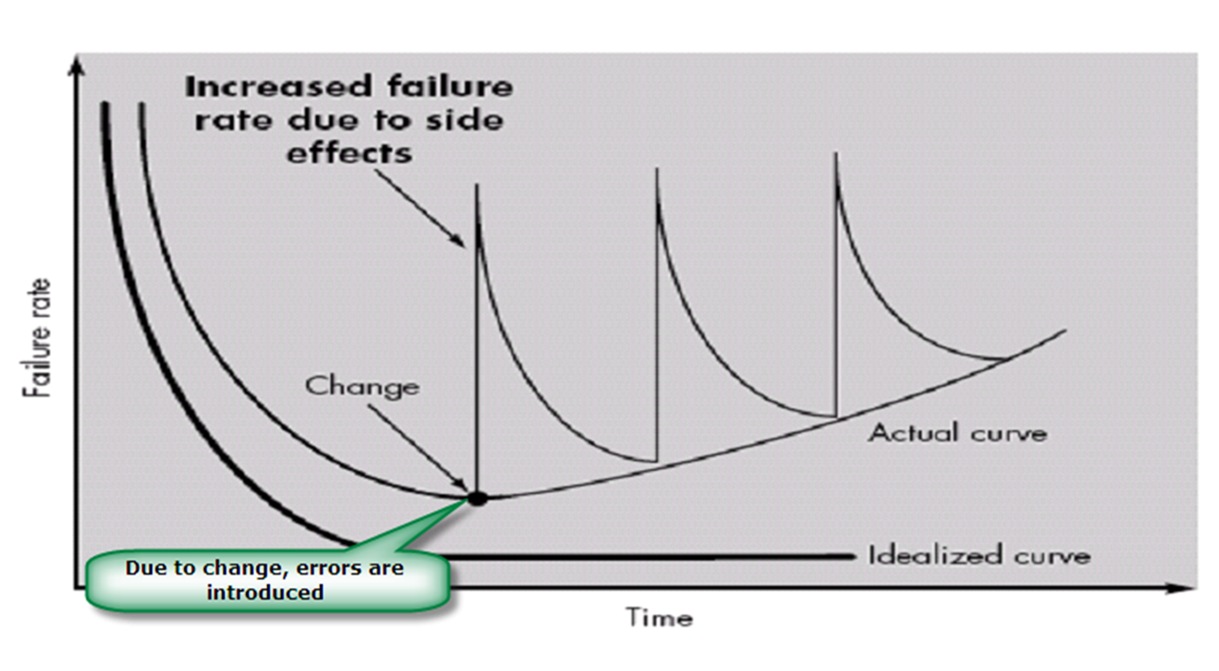
Failure Rate Curve for Software

Slide 11
Software doesn't "wear out”
Undiscovered defects will cause high failure rates early in the life of a program.
However, these are corrected and the curve flattens as shown.
The idealized curve is a gross oversimplification of actual failure models for software.
software doesn’t wear out, it does deteriorate!

Slide 12
Software continues to be custom built
A software component should be designed and implemented so that it can be reused in many different programs.
Modern reusable components encapsulate both data and the processing that is applied to the data, enabling the software engineer to create new applications from reusable parts.

Slide 13
What are the attributes of good software?
The software should deliver the required functionality and performance to the user and should be maintainable, dependable and acceptable.
Maintainability
Software must evolve to meet changing needs;
Dependability
Software must be trustworthy;

Slide 14
What are the attributes of good software?
Efficiency
Software should not make wasteful use of system resources;
Acceptability
Software must accepted by the users for which it was designed. This means it must be understandable, usable and compatible with other systems.

Slide 15
What is Software Engineering? If you don't understand it, you can't program it. If you didn't measure it, you didn't do it.
“Software Engineering is the application of a systematic, disciplined, quantifiable approach to the development, operation, and maintenance of software.”
- IEEE’90
“Software Engineering is an act of applying a collection of techniques, methodologies and tools that help with the production of a high quality software system, with a given budget, before a given deadline, while change occurs.”

Slide 16
The Role of Software Engg.
The role of software engineering is to capture the customer’s business needs and specify the “blueprints” for the system so that programmers can implement it.

Slide 17
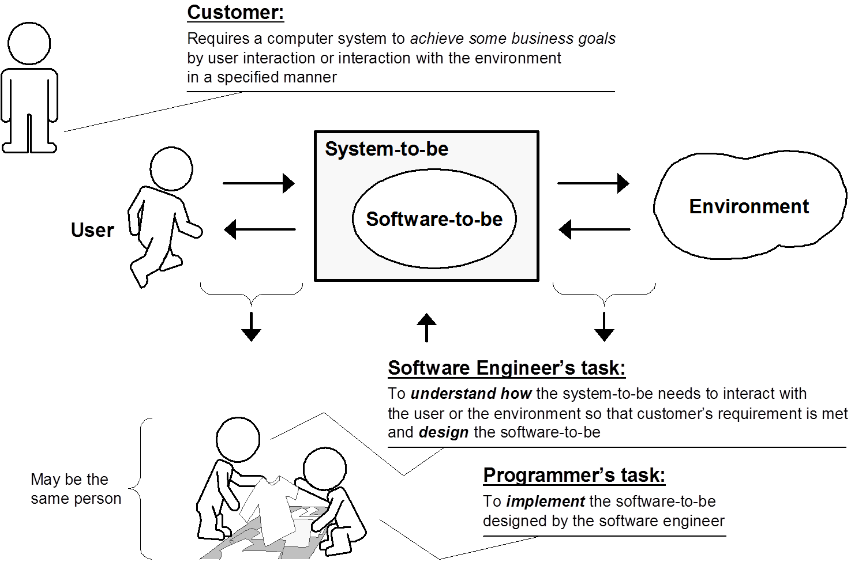

Slide 18
Objectives of Software Engineering
Understanding user conceptual model & development of better specification.
Improvement in design languages & reusable code.
Participatory design & interactive design.
Specification of interface & mockup to confirm specification.
Improving the quality of the software products.
Increasing the productivity & Giving job satisfaction to the software engineers.

Slide 19
Importance of Software Engineering
More and more, individuals and society rely on advanced software systems. We need to be able to produce reliable and trustworthy systems economically and quickly.
It is usually cheaper, in the long run, to use software engineering methods and techniques for software systems rather than just write the programs as if it was a personal programming project. For most types of system, the majority of costs are the costs of changing the software after it has gone into use.

Slide 20
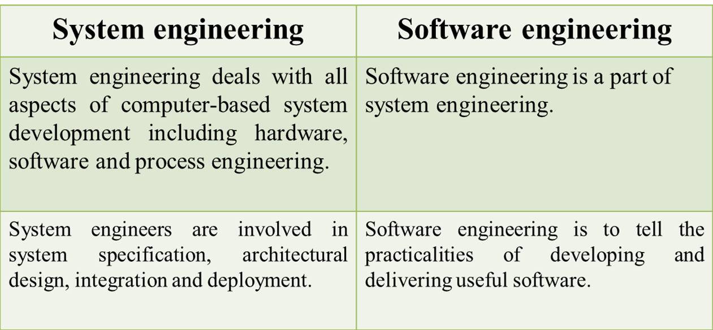
What is the difference between software engineering and system engineering?

Slide 21





Software Engineering A Layered Technology
tools
methods
a “quality” focus

Slide 22
Software Engineering A Layered Technology
A Quality Focus-
Software engineering must rest on an organizational commitment to quality.
Total quality management and similar philosophies foster a continuous process improvement culture, and this culture ultimately leads to the development of increasingly more mature approaches to software engineering.
The bedrock that supports software engineering is a quality focus

Slide 23
Software Engineering A Layered Technology
Process -
The foundation for software engineering is the process layer. Process defines a framework for a set of Key Process Areas (KPAs) that must be established for effective delivery of software engineering technology.
This establishes the context in which technical methods are applied, work products such as models, documents, data, reports, forms, etc. are produced, milestones are established, quality is ensured, and change is properly managed.

Slide 24
Software Engineering A Layered Technology
Methods -
Software engineering methods provide the technical how-to's for building software.
Methods will include requirements analysis, design, program construction, testing, and support.
This relies on a set of basic principles that govern each area of the technology and include modeling activities and other descriptive techniques.

Slide 25
Software Engineering A Layered Technology
Tools -
Software engineering tools provide automated or semi-automated support for the process and the methods.
When tools are integrated so that information created by one tool can be used by another, a system for the support of software development, called computer-aided software engineering, is established.

Slide 26
Software change
Software change is inevitable cause-
New requirements emerge when the software is used;
The business environment changes.
Discovered errors must be repaired.
New computers and equipment are added to the system.
The performance or reliability of the system may need to be improved.

Slide 27
Software Evolution
Software evolution is the term to refer to the process of developing software initially, then repeatedly updating it for various reasons.

Slide 28
Importance of evolution
Organizations have huge investments in their software systems - they are critical business assets.
To maintain the value of these assets to the business, they must be changed and updated.
The majority of the software budget in large companies is devoted to evolving existing software rather than developing new software.

Slide 29
Software Applications
System software: such as compilers, editors, file management utilities.
Application software: stand-alone programs for specific needs.
Real-time software: Software that monitors/analyzes/controls real-world events as they occur is called real time.

Slide 30
Software Applications
Personal computer software: The personal computer software market has burgeoned over the past two decades.
-Word processing, spreadsheets, computer graphics, multimedia, entertainment, database management.
Engineering/scientific software: Characterized by “number crunching “algorithms such as automotive stress analysis, molecular biology, orbital dynamics etc.

Slide 31
Software Applications
Web-based software: The Web pages retrieved by a browser are software that incorporates executable instructions (e.g., CGI, HTML, Perl, or Java), and data (e.g.,One of the most comprehensive libraries of shareware/freeware can be found at hypertext and a variety of visual and audio formats).
Embedded software resides within a product or system. (key pad control of a microwave oven, digital function of dashboard display in a car).

Slide 32
Software Applications
Product-line software focus on a limited marketplace to address mass consumer market. (word processing, graphics, database management).
WebApps (Web applications) network centric software. As web 2.0 emerges, more sophisticated computing environments is supported integrated with remote database and business applications.
Artificial intelligence software uses non-numerical algorithm to solve complex problem. Robotics, expert system, pattern recognition game playing.

